Slide 1
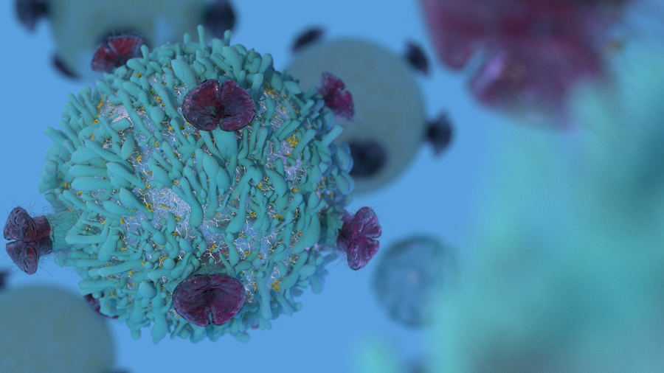


Mass Spectrometry Imaging (MSI) in Detecting Tumor Heterogeneity
UNDER SUPERVISION OF:
DR. Ahmed Morsy and DR. Walid Abdelmoula
Represented By (Team11):
Name: Ibrahim Elsayed Sec: 1 BN: 1
Name: Donia Abd Elsalam Sec: 1 BN: 30
  Name: Renad Taher Sec: 1 BN: 34
  Name: Mariem Ahmed Sec: 2 BN: 29
  Name: Mustafa Yehia Sec: 2 BN: 33

Slide 2
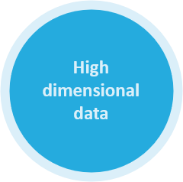




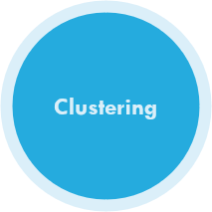



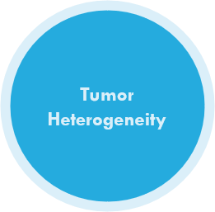
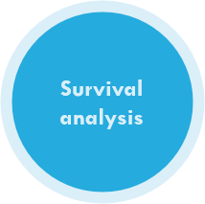
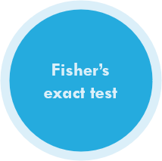
MSI in Detecting Tumor Heterogeneity
Dimensionality reduction
Statistical analysis

Slide 3

Mass
Spectrometry
Imaging
Tumor Heterogeneity
Visualizes the spatial distribution of molecules as biomarkers, proteins by their molecular masses.
Describes differences between tumors of the same type in different patients, and between cancer cells within a tumor.
Renad

Slide 4

Cancer
Second-leading cause of death in the world.
17.0 million new cancer cases.
9.5 million cancer deaths.
Breast
Cancer
Stomach
(Gastric)
Cancer
2.3 million new cases.
1 in 8 women.
Over a million new cases.

Slide 5
OBJECTIVE
Accurate Diagnosis
Of Cancer
Associated Subpopulations with Poor Survival in (Gastric)
Cancer
Associated Subpopulations with Metastasis in (Breast)
Cancer
More Personalized Therapy.
Determine tumor Subpopulation that affect Patient Outcomes.

Slide 6
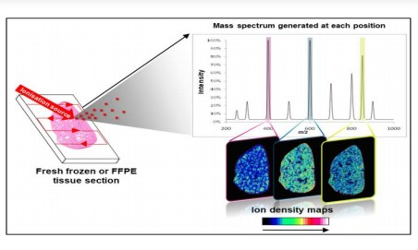

Molecular level
MSI
Total ion Count
Technique | Specialization
SIMS | Lipids
MALDI | Proteins, Peptides
DESI | Both
Feature space
Mustafa

Slide 7
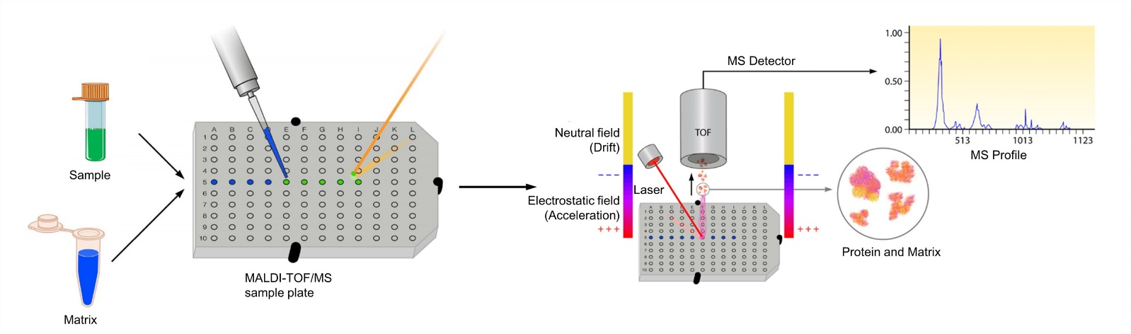
MALDI

Slide 8
DATA
Gastric Cancer data
Clinical Data
Breast cancer data

Slide 9

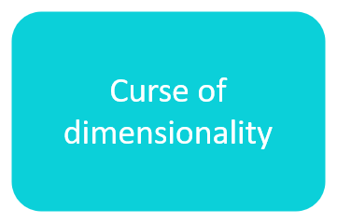


High Dimensional Data
Dimensionality reduction
Problem
Solution
linear
Nonlinear
Ibrahim

Slide 10
Curse of dimensionality
It occurs when we try to analyze or organize the data in the high-dimension space.
These phenomena occur in different domains such as numerical analysis, machine learning, etc.…..

Slide 11
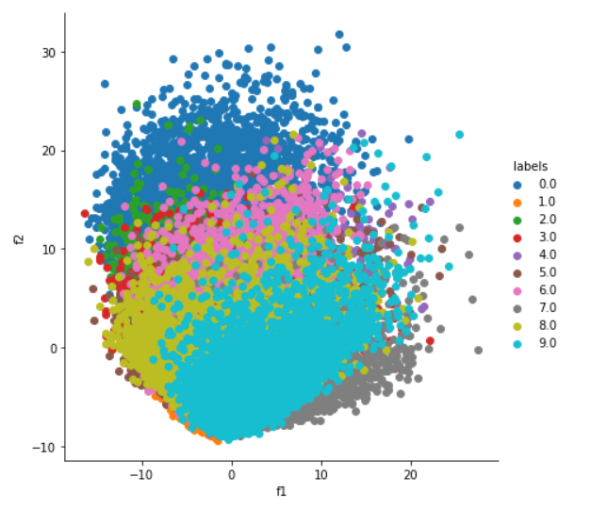
PCA
a. Applied on Mnist data

Slide 12
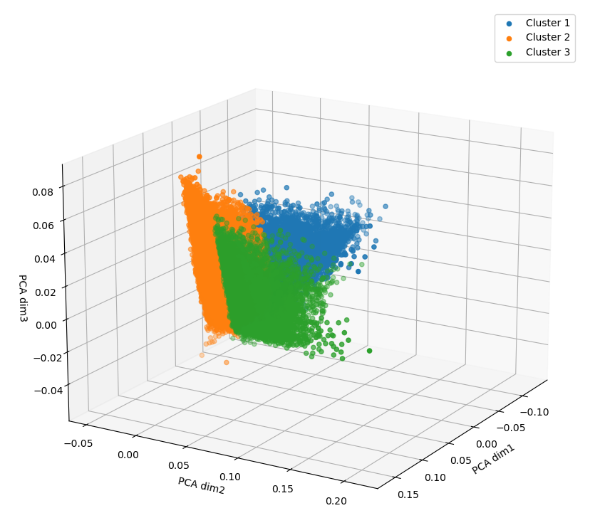
b. Applied on MSI Data (Gastric Data)

Slide 13
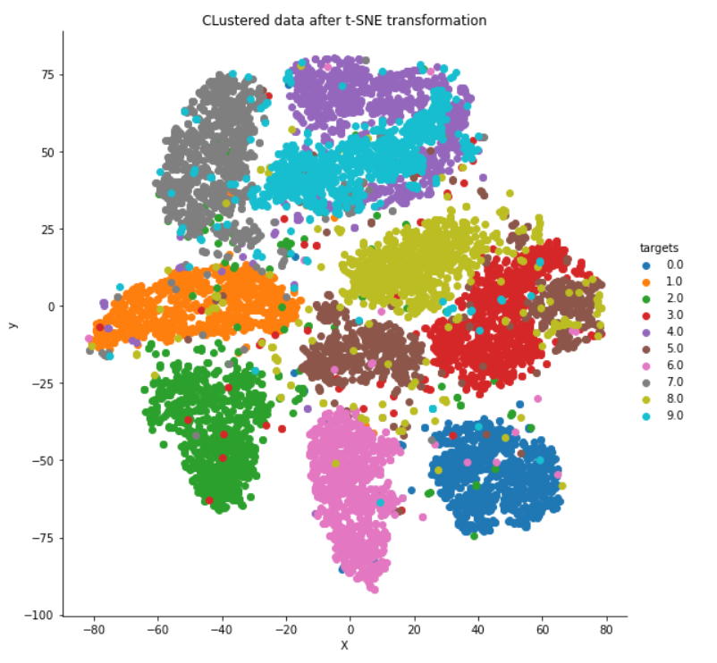
t-SNE

Slide 14
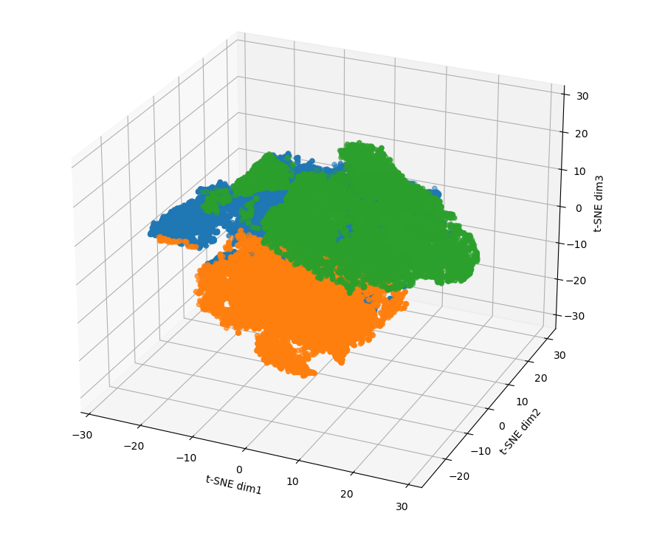
t-SNE on Gastric Data (Scatter Space)

Slide 15
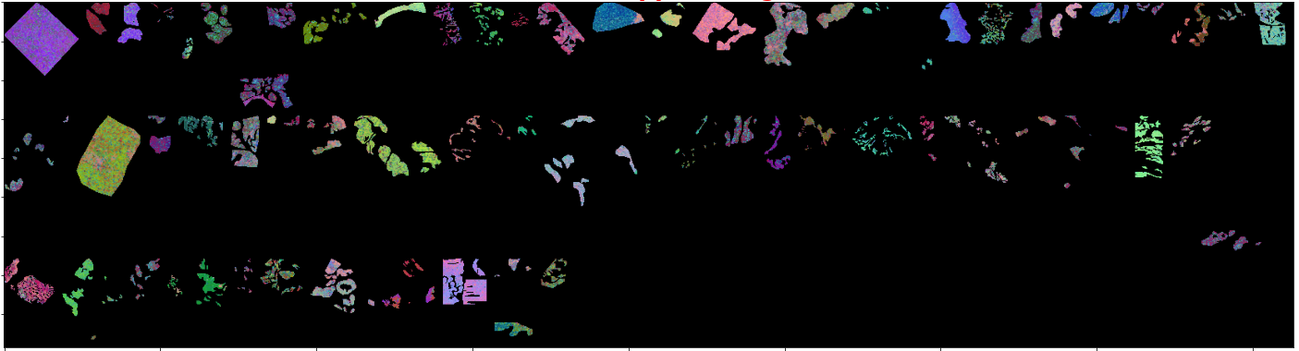
t-SNE on Gastric Data (Spatial Space)
Representing every pixel of data in high dimension to one point in the low dimensional space.

Slide 16
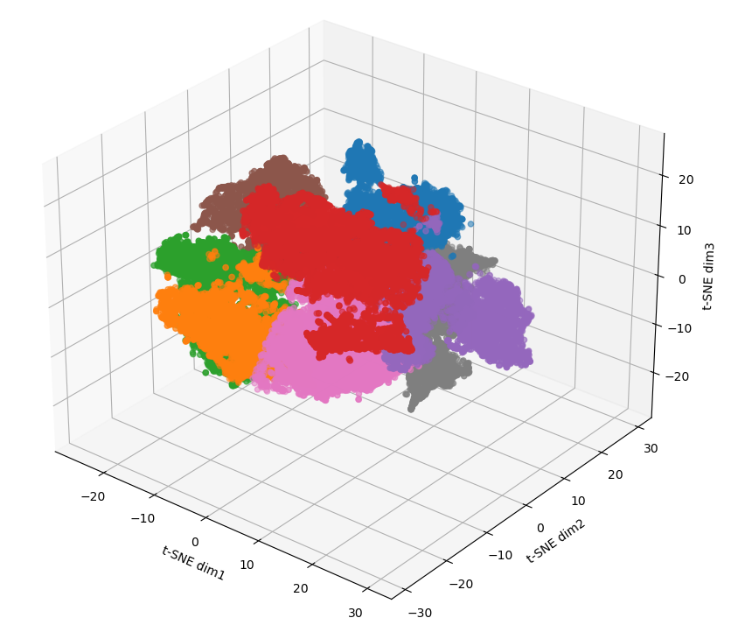
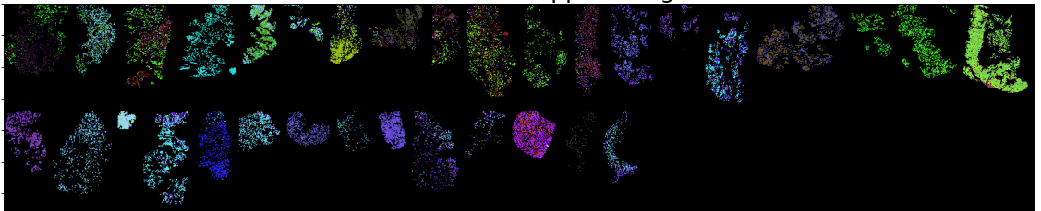
t-SNE on Breast Data (Scatter & Spatial Spaces

Slide 17

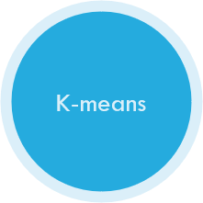



Mariam

Slide 18
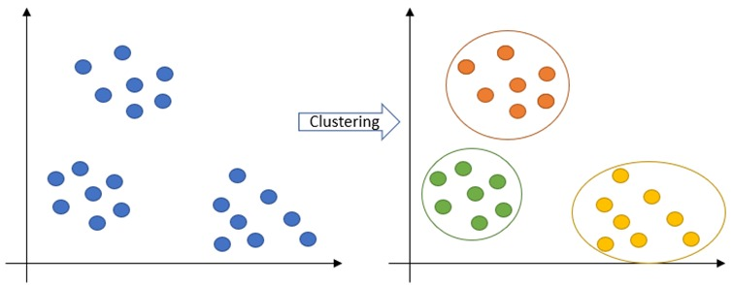
Clustering

Slide 19
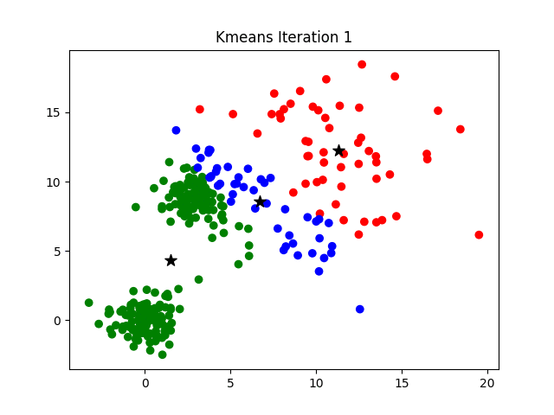
K-means

Slide 20
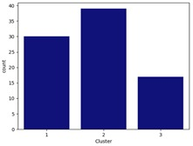
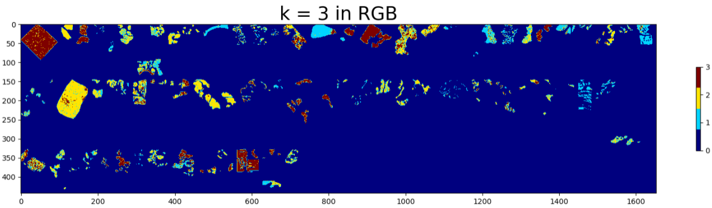
K-means on Gastric Data

Slide 21
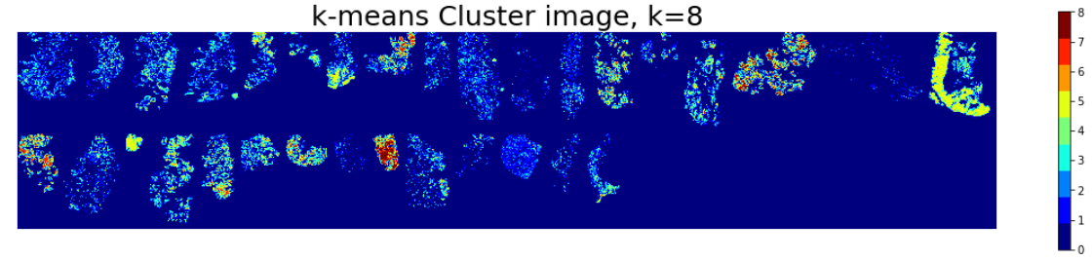
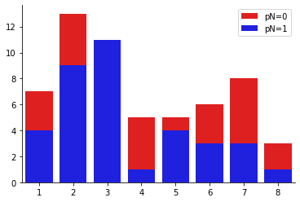
K-means on Breast Data
K-means Cluster Image, k = 8

Slide 22

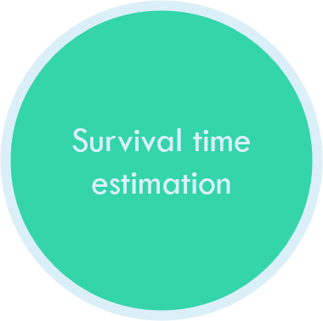
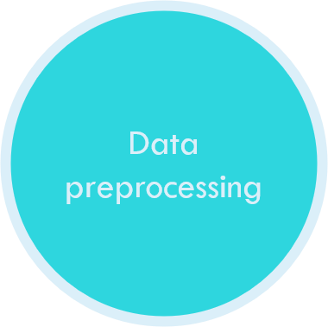
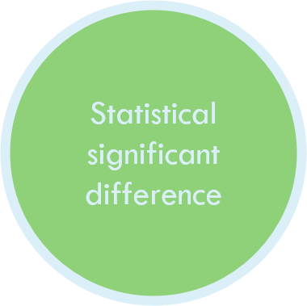
Survival analysis
Donia

Slide 23



How to assign each patient to a cluster of proteins ??

Slide 24
An image with each pixel Represents a protein subpopulation from 1 to 3 and 0 is background

Slide 25
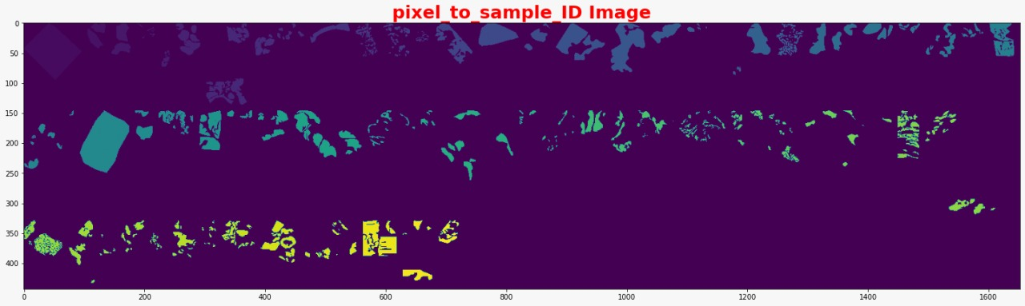
An image with each pixel Represents a patient from 0 to 63 where 0 represents background

Slide 27
Patient ID | Survival Status | Survival Time
0
…
63
cluster
Clinical Data

Slide 28


Clinical Data
Problem
Solution

Slide 29
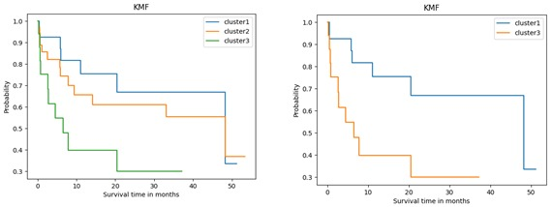
Survival Status
Survival time
Kaplan Meier curve
Cluster

Slide 30
P-value <0.05
Reject null Hypothesis
(Significant difference)
Log rank test
Null Hypothesis
Accept null Hypothesis
(No Significant difference)
P-value >0.05

Slide 31
P-value = 0.02
P-value <0.05
Reject Null hypothesis

Slide 32
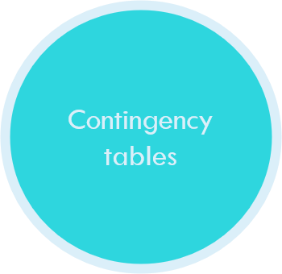
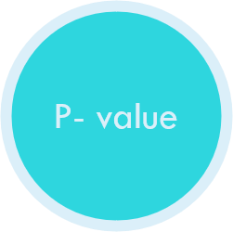
Analyze
To get
Renad

Slide 33
X | Y
Contingency tables
Lymph nodes metastasis
Clusters
Tables that condense large number of categorial variables into smaller ones, so this helps to show the relations between them.

Slide 34
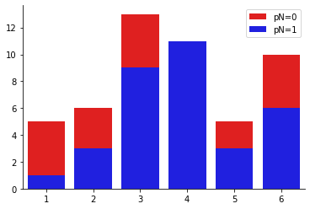
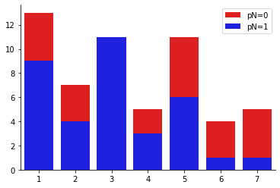
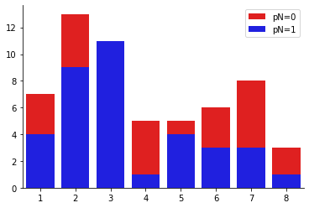
It’s a statistical significance test used to determine if there’s a significant relationship between 2 categorial variables.
K= 6, Patient Contribution
K= 7, Patient Contribution
K= 8, Patient Contribution
Number of Patients
Subpopulation Number
Subpopulation Number
Subpopulation Number

Slide 35
P- value
K= 6, Patient Contribution
K= 7, Patient Contribution
K= 8, Patient Contribution
Number of Patients
Subpopulation Number
Subpopulation Number
Subpopulation Number
P- value = 0.004824
P- value = 0.005738
P- value = 0.003732

Slide 36
P-value
<5%
Reject Null Hypothesis
Significant Relationship between the 2 categorical variables
K= 8, Patient Contribution
Knowing the value of one variable
Number of Patients
Helps to predict the value of the other variable
Subpopulation Number
P- value = 0.003732

Slide 37
Statistical Analysis ✔
SAM
Biomarkers ❌
SAM: Microarray Analysis Technique measures distance between points
False Discovery Rate
Mustafa

Slide 38
Value
Accurate Diagnosis
Effective Prognosis Tools
Mariam

Slide 39
Future Work
Biomarkers Classification
Solving small data problems
    Cross validation technique
Mariam

Slide 40
Additional Resources:
  Link to Data
  Link to Website
  Link to Poster
  Link to GitHub Repository

Slide 41
Thank You
Willing to hear your fruitful questions!

